Slide 1
Communication Summary
Communication: sharing information Local or remotely.
Telecommunication: communication at a distance.
Data communication : is the exchange of data between different devices via some form of transmission medium.

Slide 2
Technological Advancement Driving Forces
Traffic growth at a high and steady rate
Development of new services
Advances in technology
Notable Trends
Faster and cheaper, in both computing and communication
Today’s networks are more “intelligent”
The Internet
Mobility
Changes in Networking Technology
Emergence of high-speed LANs
Corporate WAN needs
Digital electronics
Notes:
Three different forces have consistently driven the architecture and evolution of
data communications and networking facilities: traffic growth, development of new
services, and advances in technology.
Communication traffic , both local (within a building or business campus) and
long distance, has been growing at a high and steady rate for decades. Network traffic
is no longer limited to voice and data and increasingly includes image and video.
Increasing business emphasis on web services, remote access, online transactions,
and social networking means that this trend is likely to continue. Thus, business
managers are constantly pressured to increase communication capacity in cost-effective
ways.
As businesses rely more and more on information technology, the range of
services that business users desire to consume is expanding. For example, mobile
broadband traffic growth is exploding as is the amount of data being pushed over
mobile networks by business users’ smart phones and tablets. In addition, over
time, mobile users are increasingly demanding high-quality services to support their
high-resolution camera phones, favorite video streams, and high-end audio. Similar
demand growth is seen in landline access to the Internet and private networks. To
keep up with mushrooming traffic generated by both consumers and business users,
mobile service providers have to keep investing in high-capacity networking and
transmission facilities. In turn, the growth in high-speed network offerings at competitive
price points encourages the expansion of mobile applications and services.
Thus, growth in services and in traffic capacity go hand in hand.

Slide 3
Simplified communication model
Source : end device
Transmitter : modem (D/A)
Transmission System : public telephone network
Receiver : modem (A/D)
Destination : end device
End device : server , pc ,workstation , phone , laptop .. etc

Slide 4
A data communication system components
Message: the information (data) to be communicated
Sender: the device that sends the data message
Receiver: the device that receives the message
Protocol: a set of rules that govern data communications
Medium: The physical path by which a message travels from sender to receiver
Transmission Lines
The basic building block of any network infrastructure or any communications facility.

Slide 5
Transmission Mediums:
Communication across a network is carried through a medium which allows a message to travel from source to destination.
Metal Wires through Cables : use electrical pulses
Plastic / glasses fiber cables : use light pulses
Wireless transmission : use modulation of specific frequency of electromagnetic waves.
Transmission Services:
Multiplexing : The ability of several devices to share a transmission facility
Compression : Squeezing the data down so that a lower-capacity
The Converging Network:
Converged data networks carry multiple services on one link including data, voice, image, and video
Host Roles:
Every computer on a network is called a host or end device.
Clients are computers that send requests to the servers to retrieve information.

Slide 6
Network Architecture:
Peer-to-Peer Network
It is possible to have a device be a client and a server in a Peer-to-Peer Network. This type of network design is only recommended for very small networks.
Client / Server Network
a form of internet network that consists of a single central computer functioning as a server and directing several other computers, referred to as clients. Clients can access shared files and information kept on the serving machine by connecting to the server. Furthermore, client-server networks are like peer-to-peer networks in principle, with the distinction that only the server may begin a transaction.

Slide 7
Intermediary Network Devices
An intermediary device interconnects end devices. Examples include switches, wireless access points, routers, and firewalls.
Management of data as it flows through a network is also the role of an intermediary device, including:
Regenerate and retransmit data signals.
Maintain information about what pathways exist in the network.
Notify other devices of errors and communication failures.

Slide 8
Topology Diagrams
Physical : illustrate the physical location of intermediary devices and cable installation.
Logical : illustrate devices, ports, and the addressing scheme of the network.
Common Types of Networks
Small Home Networks : connect a few computers to each other and the Internet.
Small Office/Home Office: enables computer within a home or remote office to connect to a corporate network.
Medium to Large Networks : many locations with hundreds or thousands of interconnected computers.
World Wide Networks : connects hundreds of millions of computers world-wide – such as the internet.

Slide 9
Categories of Networks
Local Area Network (LAN) :
Smaller scope, Owned by the same organization (private)
Data rates greater than WANs
Most common configurations are switched LANs and wireless LANs
Metropolitan Area Network (MAN) :
middle between LAN and WAN , high speed and large area (private or public)
Wide Area Network (WAN) :
Span a large geographical area
Rely in part on common carrier circuits
Typically consist of several interconnected switching nodes
Network infrastructures vary greatly in terms of:
Size of the area covered
Number of users connected
Number and types of services available
Area of responsibility

Slide 10
Alternative technologies for WANs
Circuit switching :
Uses a dedicated communications path
Connected sequence of physical links between nodes
Logical channel dedicated on each link
Rapid transmission
Packet switching :
Data are sent out in a sequence of small chunks called packets
Packets are passed from node to node along a path leading from source to destination
Frame relay :
Developed to take advantage of high data rates and low error rates
Key to achieving high data rates is to strip out most of the overhead involved with error control
Asynchronous Transfer Mode (ATM) or cell relay:
Culmination of developments in circuit switching and packet switching
Uses fixed-length packets called cells
Works in range of 10s and 100s of Mbps and in the Gbps range
Allows multiple channels with the data rate on each channel dynamically set on demand

Slide 11
The Internet
The internet is a worldwide collection of interconnected LANs and WANs (Network of networks)
LANs are connected to each other using WANs.
WANs may use copper wires, fiber optic cables, and wireless transmissions.
- The internet is not owned by any individual or group. The following groups were developed to help maintain structure on the internet:
IETF
ICANN
IAB
The purpose of the Internet, is to interconnect end systems, called hosts.

Slide 12
The Internet
Central Office (CO)
The place where telephone companies terminate customer lines and locate switching equipment to interconnect those lines with other networks
Customer Premises Equipment (CPE)
Telecommunications equipment that is located on the customer’s premises
Internet Service Provider (ISP)
A company that provides the Internet
Network Access Point (NAP)
One of several major Internet interconnection points that serve to tie all the ISPs together
Network Service Provider (NSP)
A company that provides backbone services to an Internet service provider (ISP)
Point of Presence (POP)
A site that has a collection of telecommunications equipment, usually refers to ISP or telephone company sites

Slide 13
Internet : create connections between end device and the world.
Extranet : create connections outside and organization.
Intranet : create connections inside an organization.
Network Architecture (Reliable networks)
Fault Tolerance : limits the impact of a failure by limiting the number of affected devices. Multiple paths are required for fault tolerance.
Scalability : A scalable network can expand quickly and easily to support new users and applications without impacting the performance of services to existing users.
Quality of Service (QoS) : is the primary mechanism used to ensure reliable delivery of content for all users.
Network Security :
Network infrastructure security:
Physical security of network devices.
Preventing unauthorized access to the devices.
Information Security:
Protection of the information or data transmitted over the network.

Slide 14
Network Trends
Bring Your Own Device (BYOD) : means any device, with any ownership, used anywhere.
Online collaboration : Collaborate and work with others over the network on joint projects.
Video communications : made to anyone, regardless of where they are located.
Cloud computing : allows us to store personal files or backup our data on servers over the internet. It is made possible by data centers.
Trends in the Home : Smart home technology is a growing trend that allows technology to be integrated into every-day appliances which allows them to interconnect with other devices.

Slide 15
Cont. Network Trends
Powerline Networking : can allow devices to connect to a LAN where data network cables or wireless communications are not available option. Using a standard powerline adapter.
Wireless Broadband : In addition to DSL and cable, wireless is another option used to connect homes and small businesses to the internet.
Wireless Internet Service Provider (WISP) is an ISP that connects subscribers to designated access points or hotspots.
Wireless broadband is another solution for the home and small businesses.

Slide 16
The Need for a Protocol Architecture
To transfer data several tasks must be performed:
The source must activate communications path or inform the network of destination.
The source system must check the destination is prepared to receive data.
The file transfer application on the source must check destination file management system is prepared to accept and store the file for this user.
May need file format translation.
Communications Protocols
All communications are governed by protocols.
Protocols are the rules that communications will follow.
These rules will vary depending on the protocol.
Rule Establishment
Individuals must use established rules or agreements to govern the conversation.

Slide 17
Protocols must account for the following requirements:
An identified sender and receiver
Common language and grammar
Speed and timing of delivery
Confirmation or acknowledgment requirements
Network Protocol Requirements
Message encoding
Message formatting and encapsulation
Message size
Message timing
Message delivery options:
Unicast : one to one communication.
Multicast : one to many, typically not all.
Broadcast : one to all.

Slide 18
- Network protocols define a common set of rules.
Can be implemented on devices in:
Software
Hardware
Both
Protocols have their own:
Function :
Addressing : Identifies sender and receiver.
Reliability : Provides guaranteed delivery.
Flow Control : Ensures data flows at an efficient rate.
Sequencing : Uniquely labels each transmitted segment of data.
Error Detection : Determines if data became corrupted during transmission.
Application Interface : Process-to-process communications between network applications.
Format
Rules
- Networks require the use of several protocols.

Slide 19
Elements of a Protocol (The key features of a protocol) :
Syntax : structure or format of data.
Semantics : Includes control information for coordination and error handling (meaning of each section of bits).
Timing : Includes speed matching and sequencing.
Communication tasks are organized into three layers:
Network access layer
Concerned with the exchange of data between terminals.
Transport layer
Collects mechanisms in a common layer shared by all applications.
Application layer
Contains logic to support applications.

Slide 20
THE OSI MODEL (Open Systems Interconnection)
7. Application Layer : It provides protocols that allow software to send and receive information and present meaningful data to users. (responsible for providing services to the user.)
6. Presentation Layer : prepares data for the application layer. It defines how two devices should encode, encrypt, and compress data so it is received correctly on the other end.
5. Session Layer : creates communication channels, called sessions, between devices.
4. Transport Layer : takes data transferred in the session layer and breaks it into (segments/ message) on the transmitting end.
3. Network Layer : breaking up segments into network packets and reassembling the packets on the receiving end. The other is routing packets by discovering the best path across a physical network.
2. Data Link Layer : establishes and terminates a connection between two physically-connected nodes on a network. It breaks up packets into frames and sends them from source to destination.
1. Physical Layer : responsible for the physical cable or wireless connection between network nodes. (movements of individual bits from one hop (node) to the next.)

Slide 21
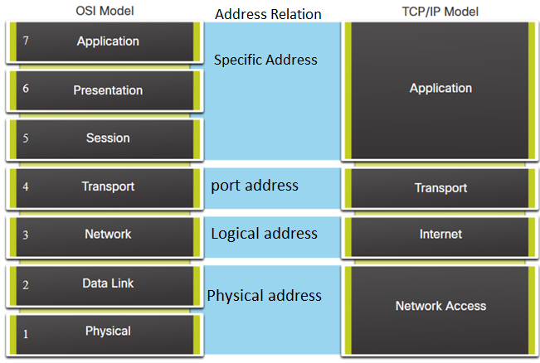
TCP/IP Model Comparison
Result of protocol research and development conducted on ARPANET
Referred to as TCP/IP protocol suite
TCP/IP comprises a large collection of protocols that are Internet standards
Data link layer and Physical may be separated.

Slide 22
Physical Layer :
Covers the physical interface between computer and network
Concerned with issues like:
Characteristics of transmission medium
Nature of the signals
Data rates
Data Link Layer :
Covers the exchange of data between an end system and the network that it is attached to.
Concerned with:
Access to and routing data across a network for two end systems attached to the same network.
Network Layer :
Implements procedures needed to allow data to travel across multiple interconnected networks.
Uses the Internet Protocol (IP) to provide routing function.
Implemented in end systems and routers.
Transport Layer :
Transmission Control Protocol (TCP)
May provide reliable end-to-end service.
Most used protocol to provide this functionality.
Application Layer :
Contains the logic needed to support the various user applications.
A separate module is needed for each different type of application.
PROTOCOL DATA UNITs (PDUs) IN TCP/IP :
DATA -> TCP SEGMENT -> IP DATAGRAM -> NETWORK PACKET

Slide 23
Traditional Internet-Based Applications
Simple Mail Transfer Protocol (SMTP)
Provides a mechanism for transferring messages among separate hosts.
File Transfer Protocol (FTP)
Used to send files from one system to another under user command.
Both text and binary files are accommodated.
Secure Shell (SSH)
Provides a secure remote login capability.
Multimedia Terminology
Media : Refers to the form of the information (text , images , audio , video).
Multimedia : Human-Computer interaction involving media also it refers to storage devices that are used to store its content.
Streaming Media : Refers to multimedia files that begin playing immediately or within seconds after it is received from the internet.

Slide 24
Multimedia Technologies
Compression
JPG for still images
MPG for video
Communications/networking
Refers to the transmission and networking technologies that can support high-volume multimedia traffic
Protocols
RTP
SIP
Quality of service (QoS)
Can deal with priority, delay constraints, delay variability constraints, and other similar requirements
Protocol Data Units
At each stage of the process, a PDU has a different name to reflect its new functions.
PDUs passing down the stack are as follows:
Data (Data Stream)
Segment
Packet
Frame
Bits (Bit Stream)

Slide 25
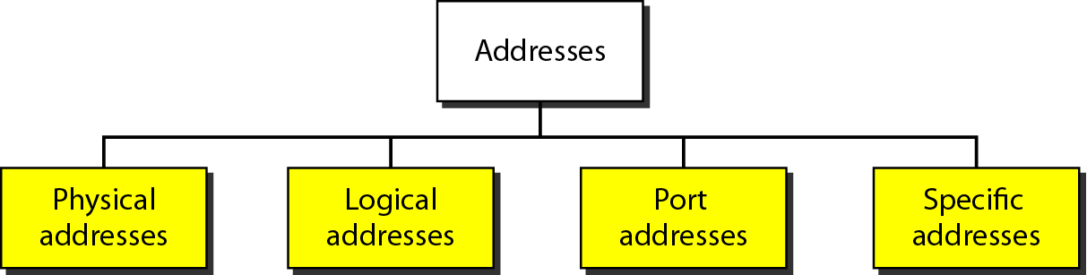
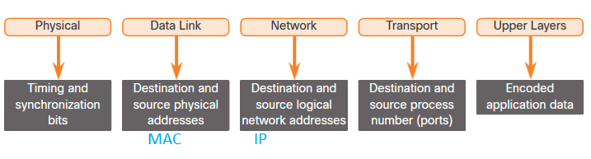
Encapsulation : is a top-down process. The level above does its process and then passes it down to the next level of the model. This process is repeated by each layer until it is sent out as a bit stream.
De-encapsulation : Data is de-encapsulated as it moves up the stack. When a layer completes its process, that layer strips off its header and passes it up to the next level to be processed. This is repeated at each layer until it is a data stream that the application can process.
ADDRESSING in TCP/IP

Slide 26
Data Transmission
Data must be transformed to electromagnetic signals to be transmitted.
REVISION THE TYPES OF THE SIGNALS.
Frequency Domain Concepts :
Signals are made up of many frequencies.
Components are sine waves.
Fourier analysis can show that any signal is made up of components at various frequencies, in which each component is a sinusoid.
A complete sine wave in the time domain can be represented by one single spike in the frequency domain.

Slide 27
Composite Signals and Periodicity
If the composite signal is periodic, the decomposition gives a series of signals with discrete frequencies.
If the composite signal is nonperiodic, the decomposition gives a combination of sine waves with continuous frequencies.
The bandwidth of a composite signal is the difference between the highest and the lowest frequencies contained in that signal.
Bandwidth in Networking :
bandwidth in hertz, refers to the range of frequencies in a composite signal or the range of frequencies that a channel can pass.
bandwidth in bits per second, refers to the speed of bit transmission in a channel or link. Often referred to as Capacity.

Slide 28
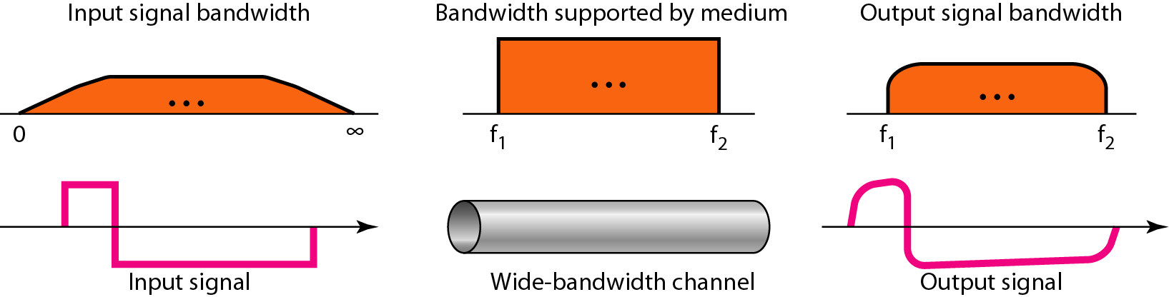
Digital signal
digital signal: a 1 can be encoded as a positive voltage and a 0 as zero voltage. A digital signal can have more than two levels. In this case, we can send more than 1 bit for each level.
A digital signal is a composite analog signal with an infinite bandwidth.

Slide 29
Why digital
Digital technology
VLSI technology has caused a continuing drop in the cost and size of digital circuits.
Data integrity
The use of repeaters has made it possible to transmit data longer distances over lower quality.
Capacity utilization
Satellite channels and optical fiber.
Security
Encryption techniques can be readily applied to digital data.
Integration: By treating both analog and digital data digitally, all signals have the same form and can be treated similarly. Thus, economies of scale and convenience can be achieved by integrating voice, video, and digital data.

Slide 30
Sending and receiving is digital but when we transmitting over network, we convert it to analog signal as a middle stage by using A/D and D/A Converter.
TRANSMISSION IMPAIRMENT :
Attenuation:
Signal strength falls off with distance over any transmission medium.
Distortion:
Means that the signal changes its form or shape (Occurs in transmission cables ).
Various frequency components arrive at different times resulting in phase shifts between the frequencies.
Noise:
Unwanted signals inserted between transmitter and receiver
Is the major limiting factor in communications system performance
There are different types of noise :
Thermal - random noise of electrons in the wire creates an extra signal
Induced - from motors and appliances, devices act are transmitter antenna and medium as receiving antenna.
Crosstalk - same as above but between two wires.
Impulse - Spikes that result from power lines, lightning, etc.

Slide 31
Signal to Noise Ratio (SNR)
We use SNR To measure the quality of a system.
It is the ratio between two powers.
It is usually given in dB and referred to as SNR_{dB.}
The values of SNR and SNRdB for a noiseless channel are
We can never achieve this ratio in real life; it is an ideal.

Slide 32
DATA RATE LIMITS
A very important consideration in data communications is how fast we can send data, in bits per second, over a channel. Data rate depends on three factors:
The bandwidth available
The level of the signals we use
The quality of the channel (the level of noise)
Increasing the levels of a signal may reduce the reliability of the system.

Slide 33
Channel Capacity
Maximum rate at which data can be transmitted over a given communications channel under given conditions
Data rate:
in bits per second (bps) at which data can be communicated
Bandwidth:
in cycles per second, or hertz
Constrained by transmitter and medium
Noise:
The average level of noise over the communications path
Error rate:
The rate at which errors occur

Slide 34
Nyquist Theorem
Nyquist gives the upper bound for the bit rate of a transmission system by calculating the bit rate directly from the number of bits in a symbol (or signal levels) and the bandwidth of the system (assuming 2 symbols/per cycle and first harmonic).
Nyquist theorem states that for a noiseless channel:
C = 2 B log₂2^{n}
C= capacity in bps
B = bandwidth in Hz
2^{n} is the number of levels

Slide 35
Shannon Capacity Formula
Considering the relation of data rate, noise and error rate
Shannon developed formula relating these to signal to noise ratio (in decibels)
SNR_{dB}⁼ 10 log₁₀ (SNR) ⁼ 10 log₁₀ (signal/noise)
Capacity C = B log₂(1+SNR)
Theoretical maximum capacity
Get much lower rates in practice
when the SNR is very high, we can assume that SNR + 1 is almost the same as SNR and we can simplify C = B * SNR_{dB}/3
The Shannon capacity gives us the upper limit; the Nyquist formula tells us how many signal levels we need.

Slide 36
Design Factors Determining Data Rate and Distance
Bandwidth
Higher bandwidth gives higher data rate
Transmission impairments
Impairments, such as attenuation, limit the distance
Interference
Overlapping frequency bands can distort or wipe out a signal
Number of receivers
More receivers introduces more attenuation

Slide 37
Physical Layer Characteristics
Physical Layer Standards address three functional areas:
Physical Components : are the hardware devices, media, and other connectors that transmit the signals that represent the bits.
Encoding : The Translation of the signal level.
Signaling : The signaling method is how the bit values, “1” and “0” are represented on the physical medium. The method of signaling will vary based on the type of medium being used.

Slide 38
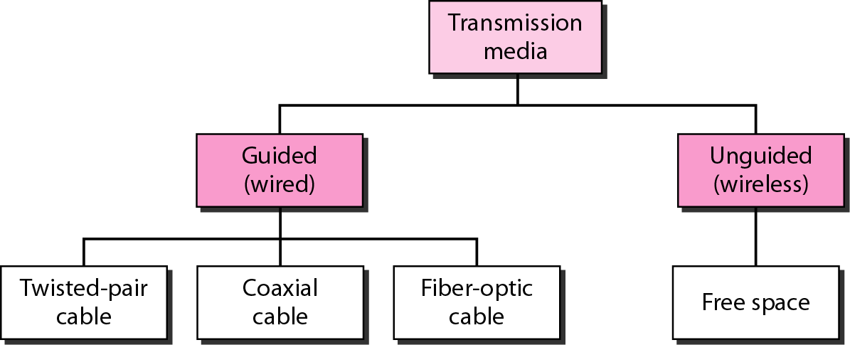
Classes of transmission media
Shielded
Unshielded

Slide 39
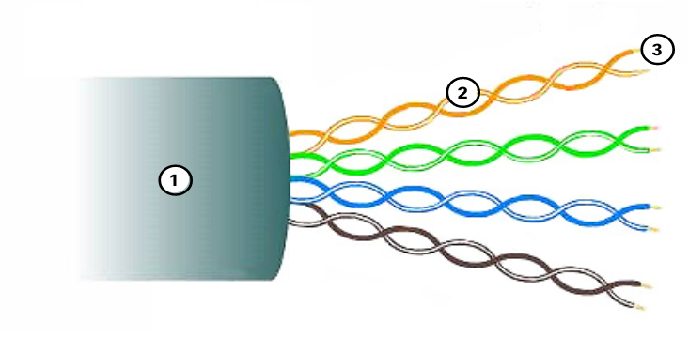
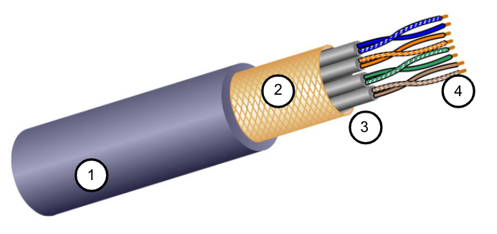
1. Guided (wired)
Twisted-Pair Cable :
Unshielded Twisted Pair (UTP) : UTP is the most common networking media.
Terminated with RJ-45 connectors
Interconnects hosts with intermediary network devices.
Key Characteristics of UTP:
The outer jacket protects the copper wires from physical damage.
Twisted pairs protect the signal from interference.
Color-coded plastic insulation electrically isolates the wires from each other and identifies each pair.
Shielded Twisted Pair (STP) : Better noise protection than UTP
More expensive than UTP
Harder to install than UTP
Terminated with RJ-45 connectors
Interconnects hosts with intermediary network devices
Key Characteristics of STP
The outer jacket protects the copper wires from physical damage
Braided or foil shield provides EMI/RFI protection
Foil shield for each pair of wires provides EMI/RFI protection
Color-coded plastic insulation electrically isolates the wires from each other and identifies each pair

Slide 40
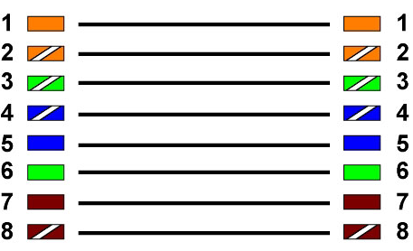
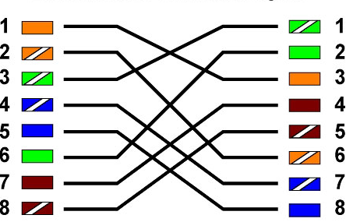
Properties of UTP Cabling
UTP has four pairs of color-coded copper wires twisted together and encased in a flexible plastic sheath. No shielding is used. UTP relies on the following properties to limit crosstalk:
Cancellation - Each wire in a pair of wires uses opposite polarity. One wire is negative, the other wire is positive. They are twisted together, and the magnetic fields effectively cancel each other and outside EMI/RFI.
Variation in twists per foot in each wire - Each wire is twisted a different amount, which helps prevent crosstalk amongst the wires in the cable.
Standards for UTP are established by the TIA/EIA. TIA/EIA-568 standardizes elements like:
Cable Types
Cable Lengths
Connectors
Cable Termination
Testing Methods
Electrical standards for copper cabling are established by the IEEE, which rates cable according to its performance
Connectors :
RJ-45 Connector
Poorly terminated UTP cable
RJ-45 Socket
Properly terminated UTP cable
Straight-through cable
Crossover cable
Host to Network Device
Host-to-Host, Switch-to-Switch, Router-to-Router

Slide 41
Twisted Pair
Twisted pair is the least expensive and most widely used guided transmission medium
Cables are twisted to provide protection against crosstalk.
When two wires in an electrical circuit are placed close together, the magnetic fields are the exact opposite of each other.
The two magnetic fields cancel each other out. They also cancel out any outside magnetic fields.
Most used in the telephone network and for communications within buildings

Slide 42
Near-End Crosstalk (NEXT)
Coupling of signal from one pair of conductors to another leads to signal interference which results attenuation.
Near end refers to coupling that takes place when the transmit signal entering the link couples back to the receive conductor pair at that same end of the link
Greater NEXT loss magnitudes are associated with less crosstalk noise

Slide 43
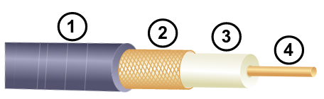
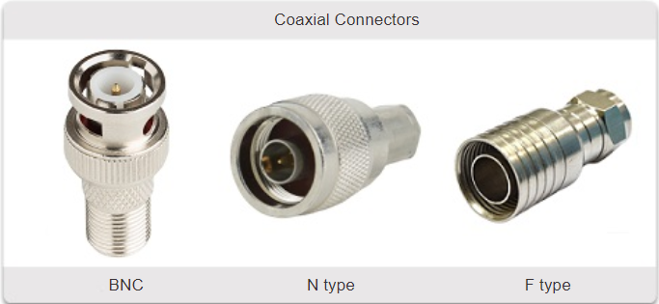
1. Guided (wired)
Coaxial Cable :
Key Characteristics
Outer cable jacket to prevent minor physical damage
A woven copper braid, or metallic foil, acts as the second wire in the circuit (outer conductor) and as a shield for the inner conductor.
A layer of flexible plastic insulation
A copper conductor is used to transmit the electronic signals.
There are different types of connectors used with coaxial cable.
Coaxial cable can be used over longer distances and support more stations on a shared line than twisted pair.
Commonly used in the following situations:
Wireless installations - attach antennas to wireless devices
Cable internet installations - customer premises wiring

Slide 44
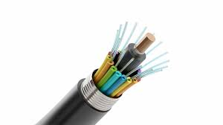
1. Guided (wired)
Fiber-Optic Cabling :
Ideal for some networking scenarios
Transmits data over longer distances at higher bandwidth than any other networking media
Less susceptible to attenuation, and completely immune to EMI/RFI
Made of flexible, extremely thin strands of very pure glass
Uses a laser or LED to encode bits as pulses of light
The fiber-optic cable acts as a wave guide to transmit light between the two ends with minimal signal loss
Fiber-optic cabling is now being used in four types of industry:
Enterprise Networks - Used for backbone cabling applications and interconnecting infrastructure devices
Fiber-to-the-Home (FTTH) - Used to provide always-on broadband services to homes and small businesses
Long-Haul Networks - Used by service providers to connect countries and cities
Submarine Cable Networks - Used to provide reliable high-speed, high-capacity solutions capable of surviving in harsh undersea environments at up to transoceanic distances

Slide 45
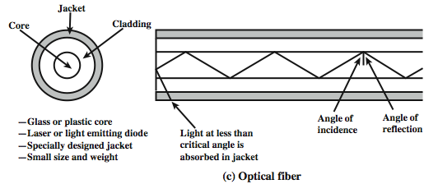
1. Guided (wired)
Fiber Connectors :
Straight-Tip (ST)
Lucent Connector (LC) Simplex
Subscriber Connector (SC)
Duplex Multimode LC
Fiber Patch Cords:
SC-SC MM Patch Cord
LC-LC SM Patch Cord
ST-LC MM Patch Cord
ST-SC SM Patch Cord
SM : Single Mode , MM : Multi Mode

Slide 46
1. Guided (wired)
Fiber Benefits :
Greater capacity
Smaller size and lighter weight
Lower attenuation and Immune to electromagnetic interference
Greater repeater spacing
The Transmission is from Electrical Digital Signal to Optical Signal (Light wave pulse) using a LED or a Laser Source and we use Converter in both sender and Receiver.
Propagation means how the light travels in the fiber optic cables from source to target.
Propagation Modes :
Single Mode
Multi Mode

Slide 47
1. Guided (wired)
Single-Mode Fiber :
Very small core
Uses expensive lasers
Long-distance applications
The light is traveling straightway as the core of the diameter is very less.
Multimode Fiber :
Larger core
Uses less expensive LEDs
LEDs transmit at different angles
Up to 10 Gbps over 550 meters
multiple modes of light propagate in it. It has more data carrying capacity due to multiple reflection inside.
Step or Graded Index
Dispersion refers to the spreading out of a light pulse over time. Increased dispersion means increased loss of signal strength. MMF has greater dispersion than SMF, with the maximum cable distance for MMF is 550 meters.

Slide 48
2. Unguided Media (wireless)
transport electromagnetic waves without using a physical conductor.
It carries electromagnetic signals representing binary digits using radio or microwave or infrared frequencies. (Wireless transmission waves)
Some of the limitations of wireless:
Coverage area - Effective coverage can be impacted by the physical characteristics of the deployment location.
Interference - Wireless is susceptible to interference and can be disrupted by many common devices.
Security - Wireless communication coverage requires no access to a physical strand of media, so anyone can gain access to the transmission.
Wireless Standards:
Wi-Fi (IEEE 802.11) : Wireless LAN (WLAN) technology. And it Requires:
Wireless Access Point (AP) : Concentrate wireless signals from users and connect to the existing copper-based network infrastructure.
Wireless NIC Adapters : Provide wireless communications capability to network hosts.
Bluetooth (IEEE 802.15) : Wireless Personal Area network (WPAN) standard.
WiMAX (IEEE 802.16) : Uses a point-to-multipoint topology to provide broadband wireless access.
Zigbee (IEEE 802.15.4) : Low data-rate, low power-consumption communications, primarily for Internet of Things (IoT) applications.

Slide 49
Wireless transmission waves
30MHz to 1GHz
Suitable for omnidirectional applications
Referred to as the radio range
used for multicast communications
1GHz to 40GHz
Referred to as microwave frequencies
Highly directional beams are possible
Suitable for point-to-point transmissions
Also used for satellite communications
3 x 10¹¹ to 2 x 10¹⁴
Infrared portion of the spectrum
Useful to local point-to-point and multipoint applications within local areas

Slide 50
Antennas
Electrical conductor used to radiate or collect electromagnetic energy.
Radio frequency electrical energy from the transmitter is converted into electromagnetic energy by the antenna and radiated into the surrounding environment.
Reception occurs when the electromagnetic signal intersects the antenna.
In two-way communication, the same antenna can be used for both transmission and reception
Power radiated in all directions
Does not perform equally well in all directions.
Radiation pattern
A graphical representation of the radiation properties of an antenna as a function of space coordinates.
Isotropic antenna
A point in space that radiates power in all directions equally.
Actual radiation pattern is a sphere with the antenna at the center.
Antenna Gain :
A measure of the directionality of an antenna.
Defined as the power output in a particular direction versus that produced by an isotropic antenna.
Measured in decibels (dB).
The increased power radiated in each direction is at the expense of other directions.
Effective area of an antenna is related to the physical size of the antenna and to its shape.

Slide 51
Terrestrial Microwave
Most common type is the parabolic “dish”.
Typical size is about 3m in diameter.
Antenna is fixed rigidly and focuses a narrow beam to achieve line-of-sight transmission to the receiving antenna.
Usually located at substantial heights above ground level.
A series of microwave relay towers is used to achieve long-distance transmission.
microwave is directional.
Applications :
Used for long telecommunications service as an alternative to coaxial cable or optical fiber.
Used for both voice and TV transmission.
1-40GHz frequencies, with higher frequencies having higher data rates.
Main source of loss is attenuation caused mostly by distance, rainfall and interference.

Slide 52
Satellite Microwave
A communication satellite is in effect a microwave relay station.
Used to link two or more ground stations.
Receives transmissions on one frequency band, amplifies or repeats the signal, and transmits it on another frequency.
Applications:
Long-distance telephone transmission
Private business networks
Television distribution
Global Positioning System (GPS)
The optimum frequency range for satellite transmission is 1 to 10 GHz
Satellites use a frequency bandwidth range of 5.925 to 6.425 GHz from earth to satellite (uplink) and a range of 3.7 to 4.2 GHz from satellite to earth (downlink)

Slide 53
Broadcast radio
is omnidirectional.
Frequencies range of 3kHz to 300GHz.
Broadcast radio (30MHz - 1GHz) covers:
FM radio and UHF and VHF television band
Data networking applications
Limited to line of sight
Suffers from multipath interference
Reflections from land, water, man-made objects

Slide 54
Infrared
Infrared signals can be used for short-range communication in a closed area using line-of-sight propagation.
Does not penetrate walls
No licensing is required
Wireless Propagation
Ground Wave Propagation : follows the contour of the earth
Sky Wave Propagation :
A signal from an earth-based antenna is reflected from the ionized layer of the upper atmosphere back down to earth
Sky wave signals can travel through several hops, bouncing back and forth between the ionosphere and the earth’s surface
Line-of-Sight Propagation : the straight-line propagation with no obstacles of light waves
Notes:
Line-of-Sight Transmission :
Free space loss
Loss of signal with distance
Atmospheric Absorption
From water vapor and oxygen absorption
Multipath
Multiple interfering signals from reflections
Refraction
Bending signal away from receiver

Slide 55
Signal Encoding Techniques
Signal and Data : (Signal Carrier)
Digital data, digital signal Transmission :
Digital signal
Sequence of discrete voltage pulses
Each pulse is a signal element
Binary data are transmitted by encoding each data bit into signal elements
Line coding and decoding:
Converting a digital data of 1’s and 0’s into a sequence of signals (voltage level (+V) and a low voltage level (0 or -V)).
Relationship between data rate and signal rate:
The data rate defines the number of bits sent per sec (bps).
The signal rate is the number of signal elements sent in a second and is measured in bauds.

Slide 56
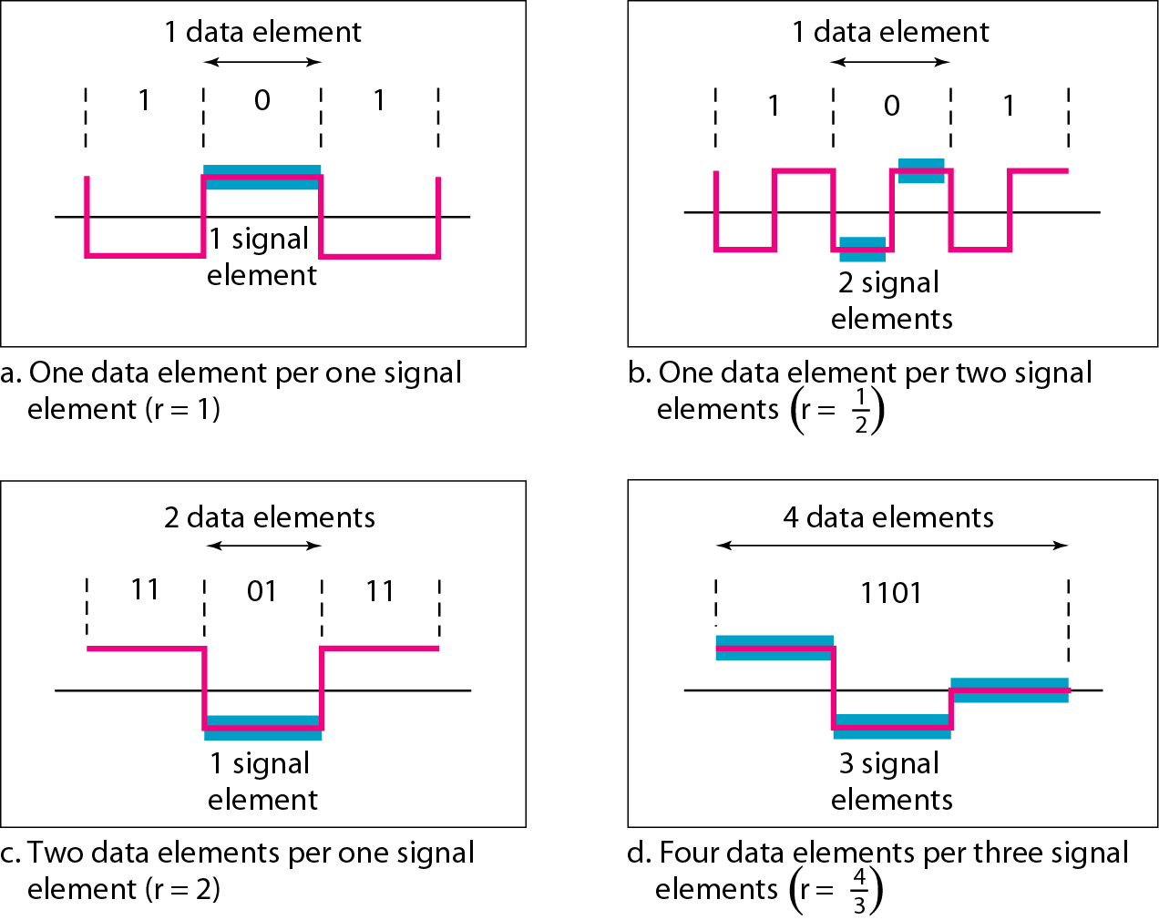

Mapping Data symbols onto Signal levels
A data symbol (or element) can consist of several data bits
A data symbol can be coded into a single signal element or multiple signal elements
The ratio ‘r’ is the number of data elements carried by a signal element.
($r=\frac{ⅆata element}{signal element}$)

Slide 57
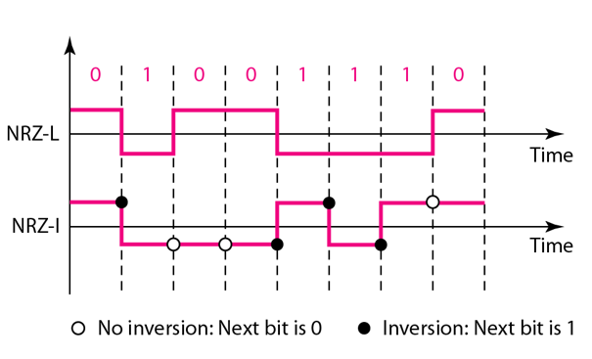
Definition of Digital Signal Encoding Formats
Nonreturn to Zero (NRZL) :
0 : represents high level , 1 : represents low level. (maybe the opposite)
Nonreturn to Zero Inverted (NRZI):
0 : represents no transition, 1 : a transition from low to high and vice versa
Notes:
Assume we Start from High.

Slide 58
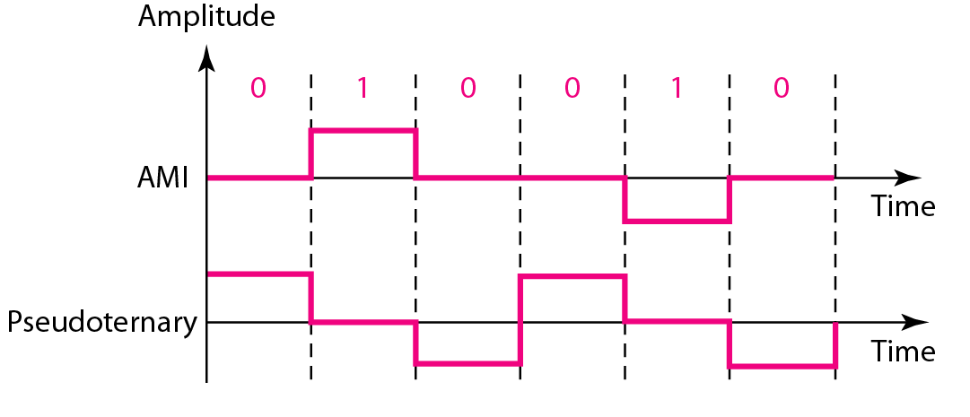
Definition of Digital Signal Encoding Formats
Bipolar-AMI:
0 : 0 voltage (no line signal), 1: positive or negative level alternating
Pseudoternary:
0 : positive or negative level alternating, 1 : 0 voltage (no line signal)

Slide 59
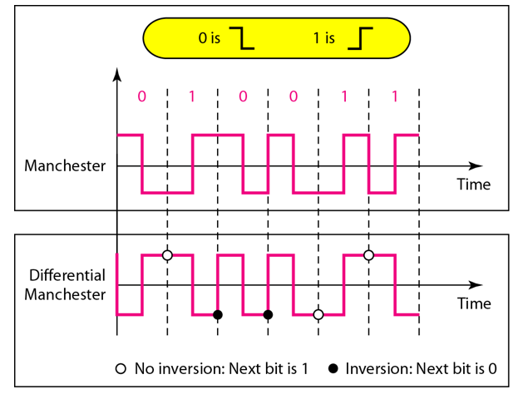
Definition of Digital Signal Encoding Formats
Manchester : (There is a Transition at the middle of each period)
0 : High to low transition, 1: Low to High transition.
Differential Manchester : (There is a Transition at the middle of each interval)
0 : transition at beginning of the interval, 1 : no transition at beginning.

Slide 60
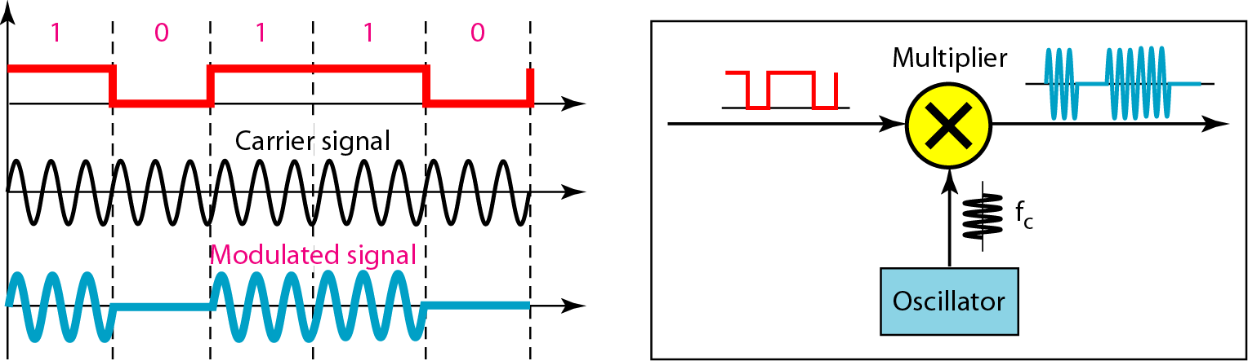
Cont. Signal and Data
Digital Data, Analog Signal :
A carrier signal (frequency fc) performs the function of transporting the digital data in an analog waveform.
Uses modem (modulator-demodulator) to convert digital data to analog signals and vice versa
Modulation techniques for transforming digital data into analog signals :
Amplitude Shift Keying (ASK) :
ASK is implemented by changing the amplitude of a carrier signal to reflect amplitude levels in the digital signal.
Encode 0/1 by different carrier amplitudes

Slide 61
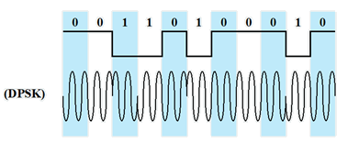
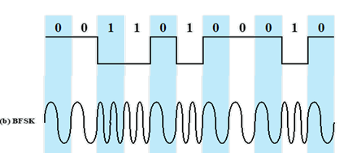
Modulation techniques for transforming digital data into analog signals
Binary Frequency Shift Keying (BFSK) :
Two binary values are represented by two different frequencies
Phase Shift Keying (PSK):
The phase of the carrier signal is shifted to represent data
Binary PSK
Two phases represent the two binary digits
Differential PSK
Phase shifted relative to previous transmission rather than some reference signal

Slide 62
Cont. Signal and Data
Analog Data, Digital Signal :
Digitization is the conversion of analog data into digital data
Analog to digital conversion is done using a codec :
Pulse code modulation (PCM) :
consists of three steps to digitize an analog signal:
Sampling : Using Pulse Amplitude Modulation (PAM) , ideal or Natural or flat top Sampling
Quantization : a method of assigning integer values in a specific range to sampled instance
Binary encoding : translate the quantized samples to equivalent binary code
Before we sample, we must filter the signal to remove high frequency components that affect the signal shape.
The result of PAM is a series of pulses with amplitude values between the maximum and minimum amplitudes of the signal with real values.
Delta modulation:
Analog input is approximated by a staircase function
Move up or down one level (δ) at each sample interval
Binary behavior :
Function moves up or down at each sample interval
Moving up: generating 1
Moving down: generating 0
Analog Data, Analog Signal

Slide 63
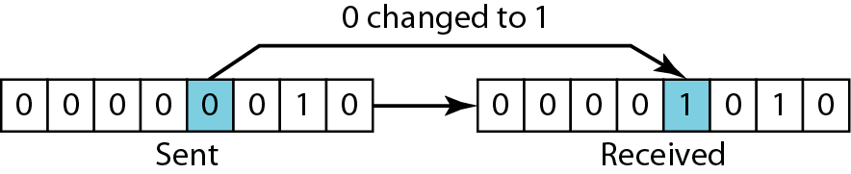
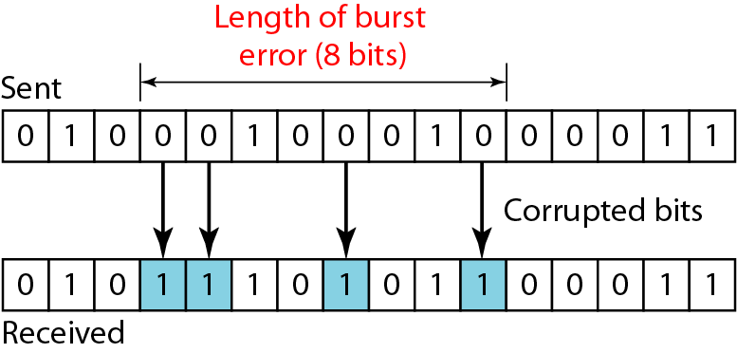
Types of Errors
Single bit errors
one bit in the data unit has changed
Burst errors
two or more bits in the data unit have changed
Data can be corrupted during transmission.
An error occurs when a bit is altered between transmission and reception
To detect or correct errors, we need to send extra (redundant) bits with data.

Slide 64
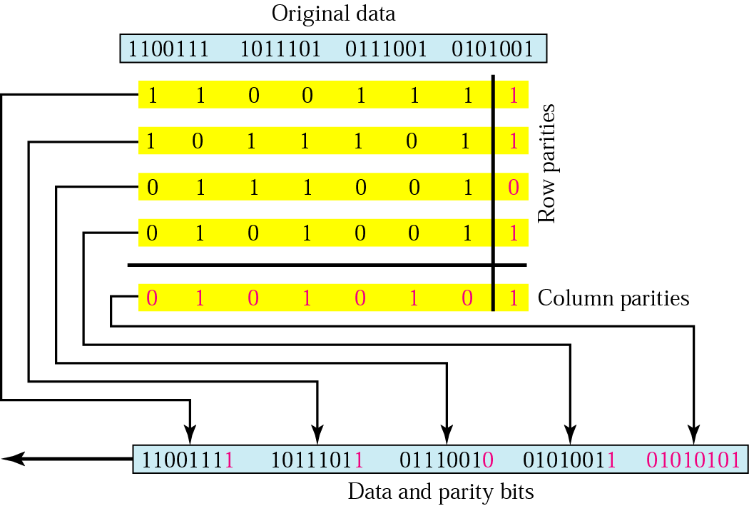
Error Detection
Simple Parity check :
1 is added to the block if it contains odd number of 1’s, otherwise 0 is added.
A simple parity-check code can detect an odd number of errors.
Two-dimensional Parity check : (row and column check for 2d matrix)
Parity check bits are calculated for each row, which is equivalent to a simple parity check bit.
Parity check bits are also calculated for all columns, then both are sent along with the data.
At the receiving end these are compared with the parity bits calculated on the received data.

Slide 65
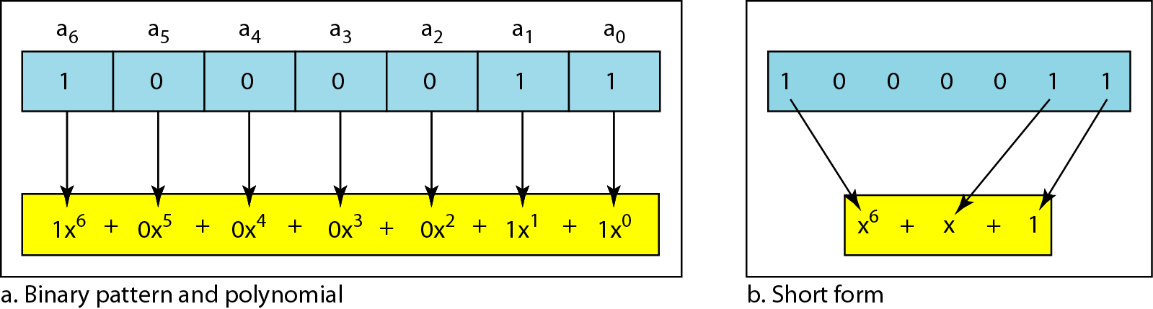
Error Detection
Checksum :
The data is divided into k segments each of m bits.
In the sender’s end, the segments are added. The sum is complemented (1’s complement) to get the checksum.
The checksum segment is sent along with the data segments.
At the receiver’s end, all received segments are added. The sum is complemented.
If the result is zero, the received data is accepted; otherwise discarded.
Cyclic redundancy check :
Given a k bit block of bits, the transmitter generates an (n – k) bit frame check sequence (FCS) which is exactly divisible by some predetermined number
Receiver divides the incoming frame by that number
If there is no remainder, assume there is no error
Add (n-1) zeros to data at sender where n is the divisor length to compute remainder then divide the code word into divisor by XORing the bits and shifting while using zeros in the left.
Polynomial to represent a binary word:
The divisor in a cyclic code is normally called the generator

Slide 66
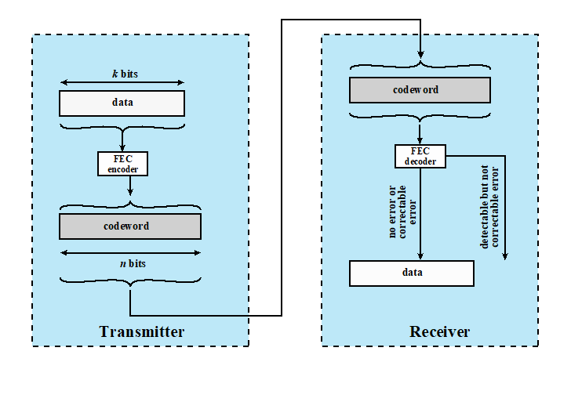
Forward Error Correction
Correction of detected errors usually requires data blocks to be retransmitted
Not appropriate for wireless applications:
The bit error rate (BER) on a wireless link can be quite high, which would result in many retransmissions
Propagation delay is very long compared to the transmission time of a single frame
Need to correct errors on basis of bits received

Slide 67
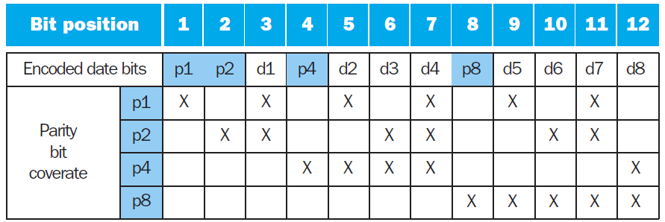
Hamming Code
To calculate Hamming Error Correction Code (ECC):
Number bits from 1 on the left
All bit positions that are a power 2 are parity bits
Each parity bit checks certain data bits:
P1 checks bits (1,3,5,7,9,11,...)
P2 checks bits (2,3,6,7,10,11,14,15,…)
P4 checks bits (4–7, 12–15, 20–23,…)
P8 checks bits (8–15, 24–31, 40–47,...)

Slide 68
Multiplexing
Bandwidth utilization is the wise use of available bandwidth.
Efficiency can be achieved by multiplexing; i.e., sharing of the bandwidth between multiple users.

Slide 69
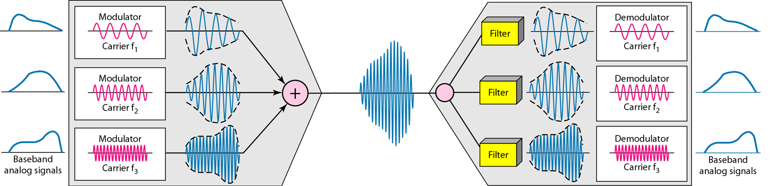
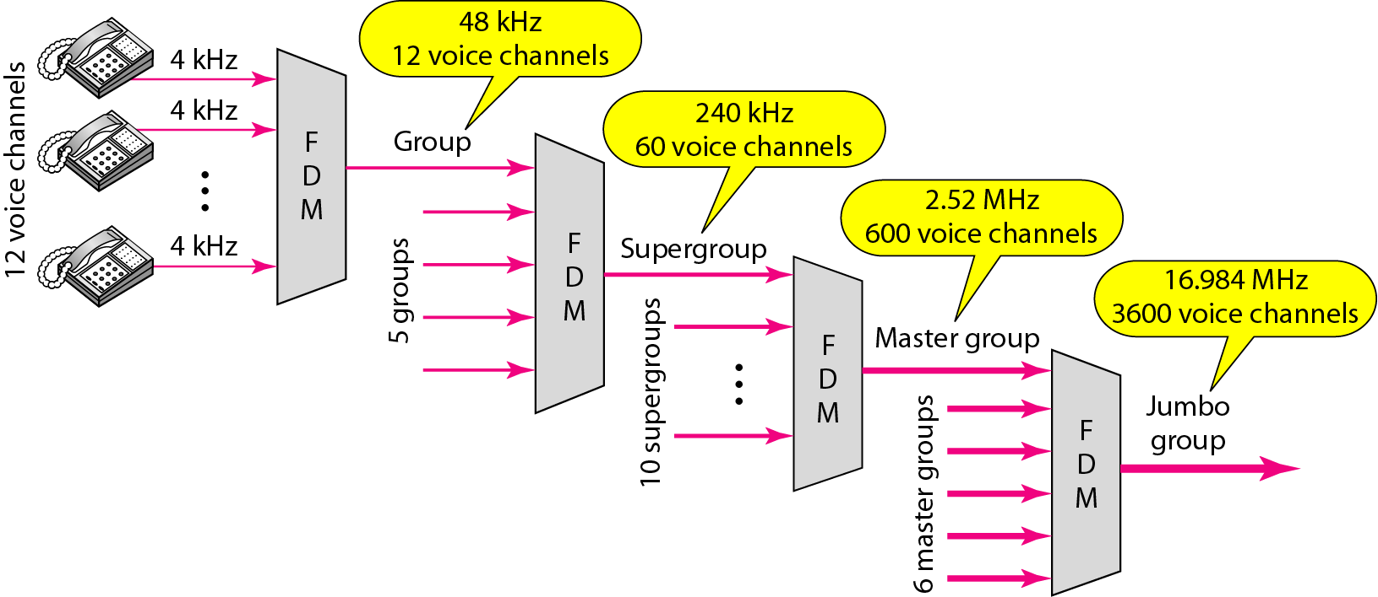
Categories of multiplexing
Frequency-division (FDM ) :
Analog Carrier Systems :
Long-distance links use an FDM hierarchy
AT&T (USA) and ITU-T (International) variants
Group
12 voice channels (4kHz each) = 48kHz
Range 60kHz to 108kHz
Super group
FDM of 5 group signals supports 60 channels
Carriers between 420kHz and 612 kHz
Master group
FDM of 10 supergroups supports 600 channels
Original signal can be modulated many times

Slide 70
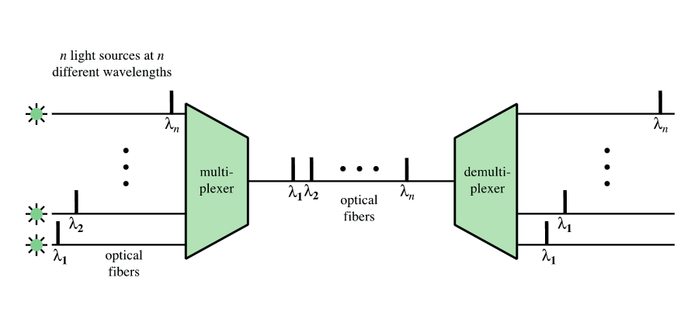
Categories of multiplexing
Wavelength-division (WDM):
is an analog multiplexing technique.
Multiple beams of light at different frequencies
Carried over optical fiber links
Dense Wavelength Division Multiplexing (DWDM)

Slide 71
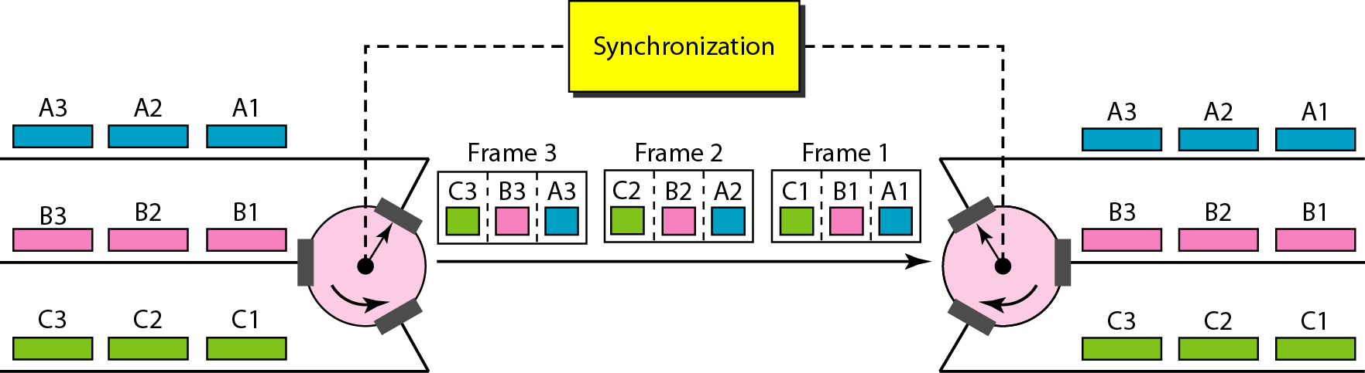
Categories of multiplexing
Time-division (TDM) :
is a digital multiplexing technique for combining several digital channels into one high-rate one.
Interleaving : The process of taking a group of bits from each input line for multiplexing.

Slide 72
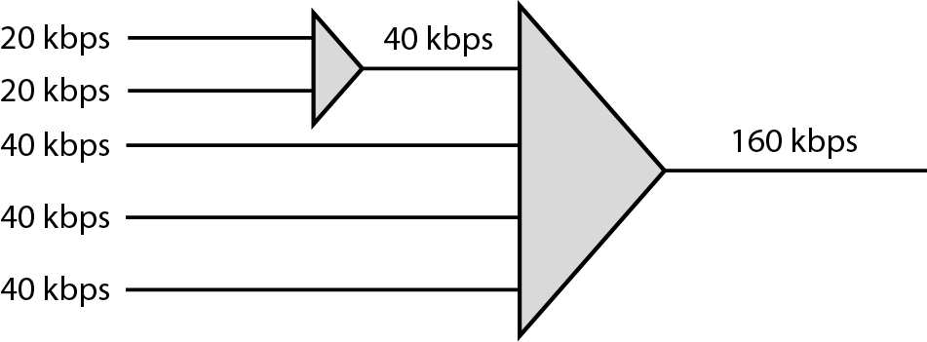
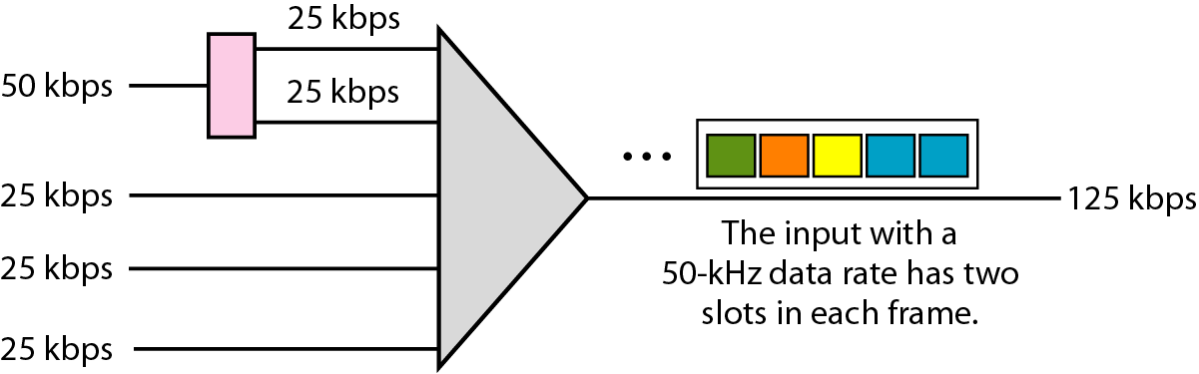
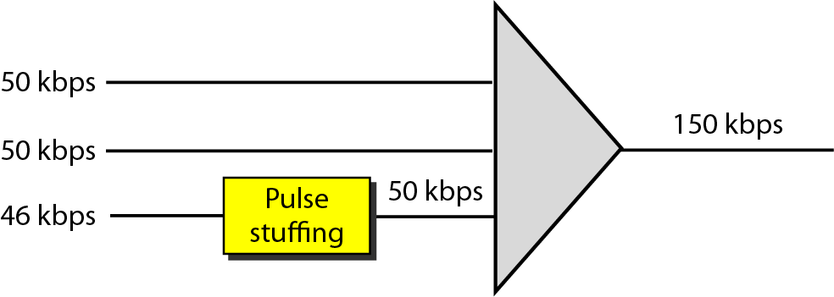
Data Rate Management
Multilevel
Not all input links maybe have the same data rate.
Some links maybe slower. There maybe several different input link speeds
strategies that can be used to overcome the data rate mismatch:
Multilevel
Multi-slot
Pulse stuffing
Multi-slot

Slide 73
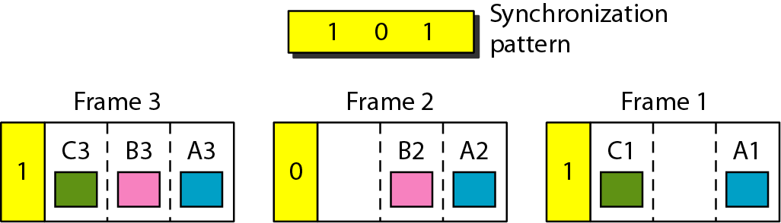
Synchronization pattern
To ensure that the receiver correctly reads the incoming bits, i.e., knows the incoming bit boundaries to interpret a “1” and a “0”, a known bit pattern is used between the frames.
The receiver looks for the anticipated bit and starts counting bits till the end of the frame.
Then it starts over again with the reception of another known bit.
These bits (or bit patterns) are called synchronization bit(s).
They are part of the overhead of transmission.

Slide 74
Cable Modems
Downstream
Cable scheduler delivers data in small packets
Active subscribers share downstream capacity
Also allocates upstream time slots to subscribers
Upstream
User requests timeslots on shared upstream channel
Headend scheduler notifies subscriber of slots to use
Cable Spectrum Division :
the cable spectrum is divided in to three ranges:
User-to-network data (upstream): 5 - 40 MHz
Television delivery (downstream): 50 - 550 MHz
Network to user data (downstream): 550 - 750 MHz

Slide 75
Asymmetrical Digital Subscriber Line (ADSL)
Link between subscriber and network
Uses currently installed twisted pair cable
Is Asymmetric - bigger downstream than up
Uses Frequency Division Multiplexing
Reserve lowest 25kHz for voice (POTS)
Uses echo cancellation or FDM to give two bands
Has a range of up to 5.5km

Slide 76
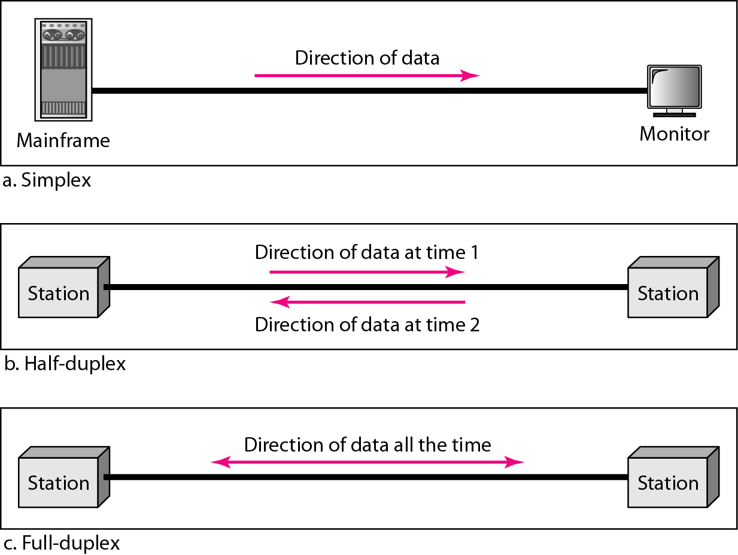
Half and Full Duplex Communication
Half-duplex communication
Only allows one device to send or receive at a time on a shared medium.
Full-duplex communication
Allows both devices to simultaneously transmit and receive on a shared medium.
Ethernet switches operate in full-duplex mode.

Slide 77
Physical and Logical Topologies
Physical topology : shows physical connections and how devices are interconnected.
Logical topology : identifies the virtual connections between devices using device interfaces and IP addressing schemes.
Purpose of the Data Link Layer :
The Data Link layer is responsible for communications between end-device network interface cards.
It allows upper layer protocols to access the physical layer media and encapsulates Layer 3 packets (IPv4 and IPv6) into Layer 2 Frames.
It also performs error detection and rejects corrupts frames.
Layer 2 Addresses : Also referred to as a physical address.
Contained in the frame header.
Used only for local delivery of a frame on the link.
Updated by each device that forwards the frame.

Slide 78

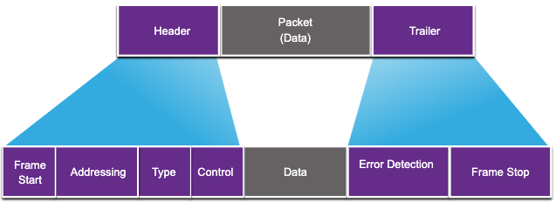
Data Link Frame
Data is encapsulated by the data link layer with a header and a trailer to form a frame.
A data link frame has three parts:
Header
Data
Trailer
The fields of the header and trailer vary according to data link layer protocol.
The amount of control information carried with in the frame varies according to access control information and logical topology.
Field | Description
Frame Start and Stop | Identifies beginning and end of frame
Addressing | Indicates source and destination nodes
Type | Identifies encapsulated Layer 3 protocol
Control | Identifies flow control services
Data | Contains the frame payload
Error Detection | Used for determine transmission errors

Slide 79
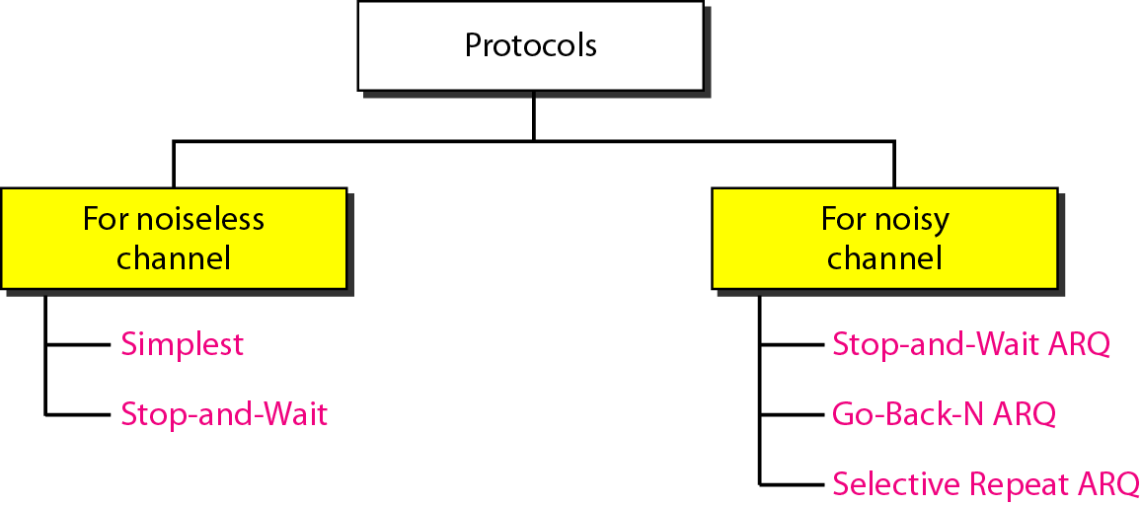
Data Link Control Protocols
Frame synchronization
Flow control :
refers to a set of procedures used to restrict the amount of data that the sender can send.
In the absence of flow control, the receiver’s buffer may fill up and overflow while it is processing old data
Error control :
is based on automatic repeat request, which is the retransmission of data.
Lost frames
a frame fails to arrive at the other side
Damaged frames
frame arrives but some of the bits are in error
Addressing
Control and data
Link management

Slide 80
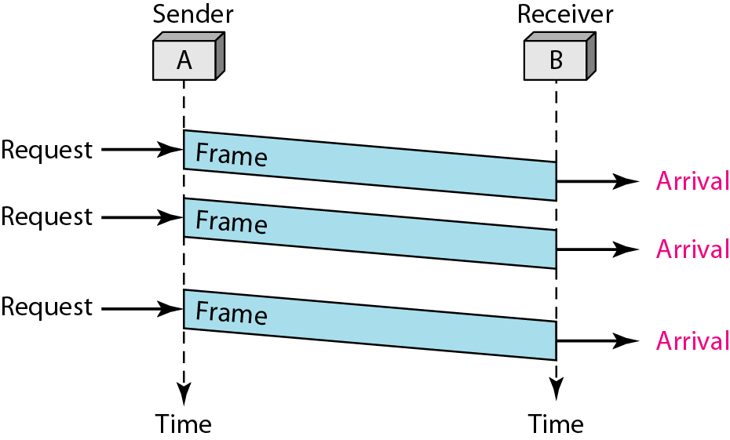
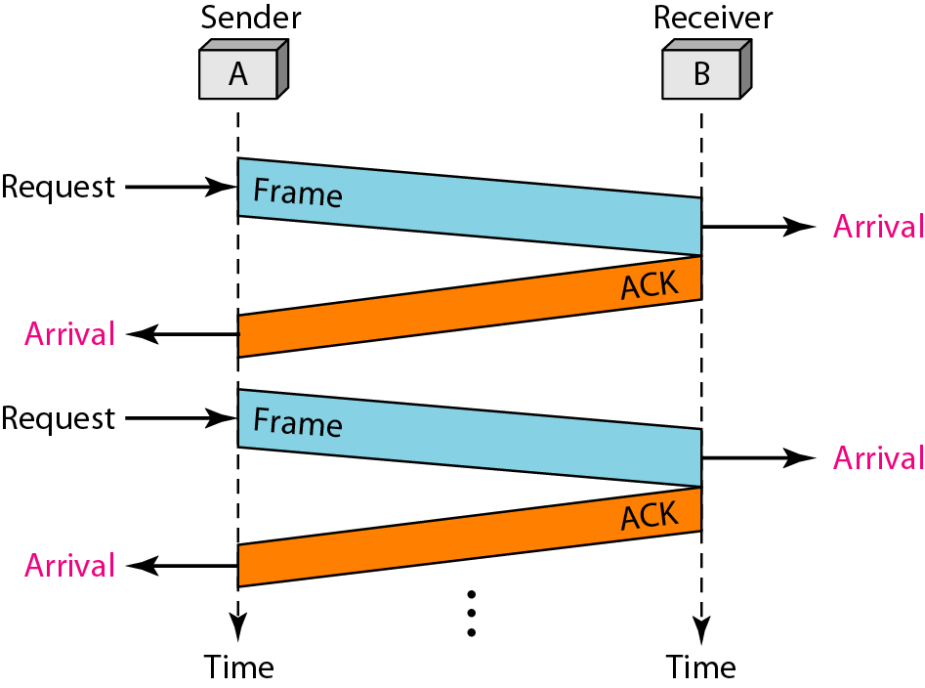
Noiseless channel protocol
Simplest
Stop and wait
Source transmits frame
Destination receives frame and replies with acknowledgement (ACK)
Source waits for ACK before sending next frame
Destination can stop flow by not sending ACK

Slide 81
Noisy channel protocol
Automatic Repeat Request (ARQ) :
Stop-and-wait
Source transmits single frame
Waits for ACK
No other data can be sent until destination’s reply arrives
If frame received is damaged, discard it
Transmitter has timeout
If no ACK within timeout, retransmit
If ACK is damaged, transmitter will not recognize
Transmitter will retransmit
Receiver gets two copies of frame
Use alternate numbering and ACK0 / ACK1
Go-back-N
Selective-Repeat

